Slide 1
Audio Separator Plugin
Alex Nishio and Michael Szostak

Slide 2
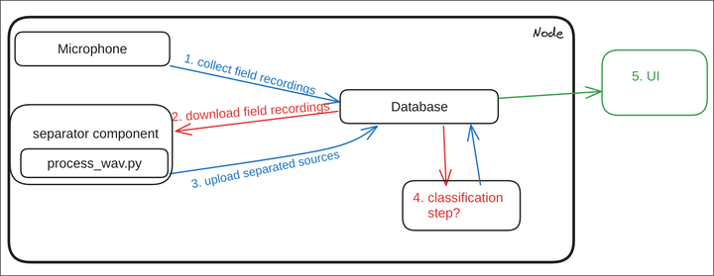
Design
Microphone Node is activated by Docker Container
Field Recordings are sent to a database
An inference model is ran on the database that analyzes the wav files and keeps only the important wav files
Classification Model
User Interface
Credit to Michael
Steps 1~3 are uploaded on Michael’s GitHub page
Steps 4 and 5 are future improvements

Slide 3
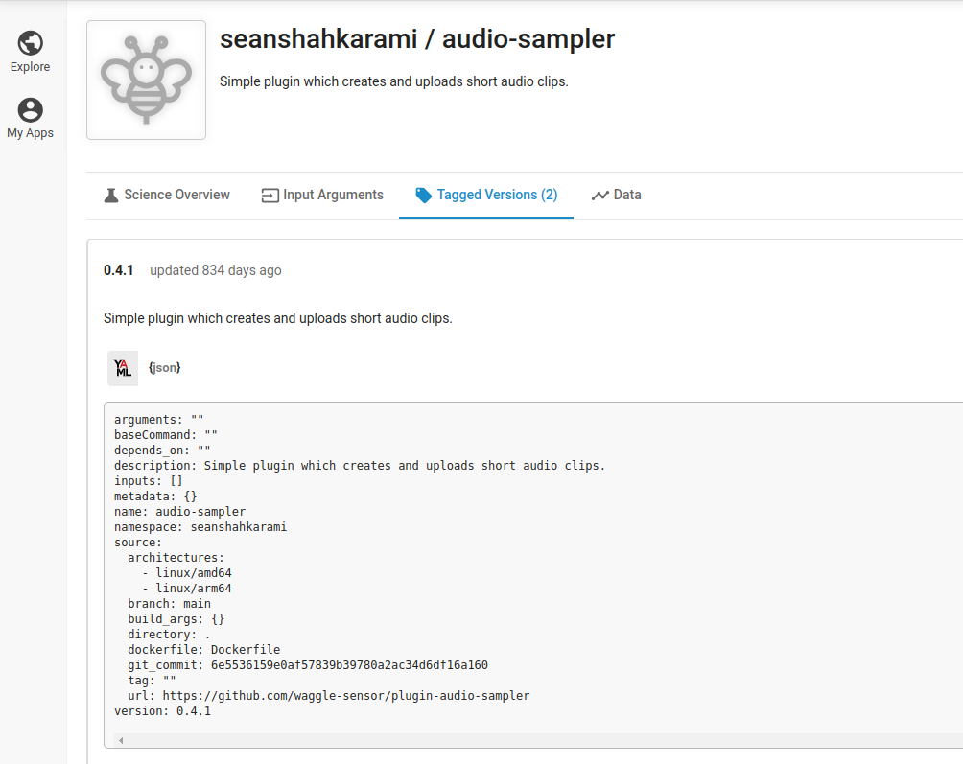
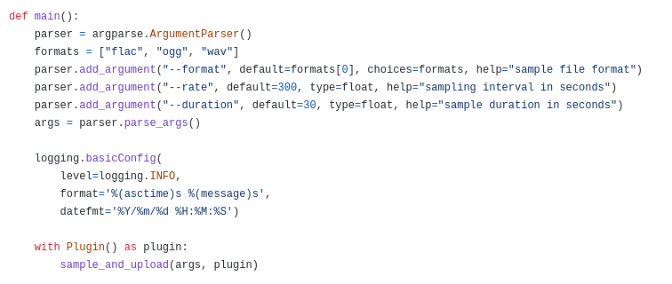
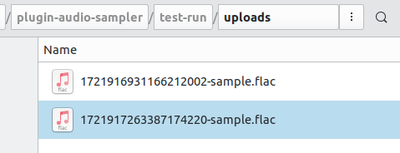
Microphone Portion (Step 1 and 2)
Can tune the time intervals and length of clip here
Sean’s Implementation of the Audio Sampler can be directly used
30 second clips recorded in 5 min intervals stored in a file storage system

Slide 4
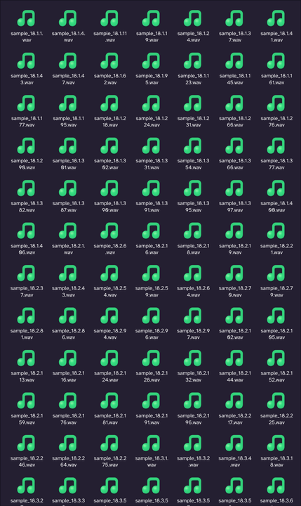
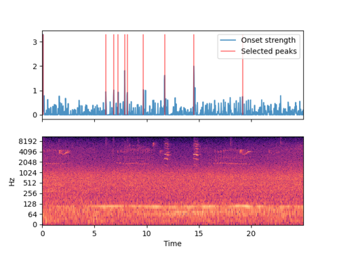
Results of Peak Finder Script (Step 3)
More information can be found in Michael’s repository
Red lines indicate peak sounds (important sounds)
Proof that the separated files are present

Slide 5
Future Improvements
Finishing Steps 4 and 5
Add a classification model to distinguish audio files
Create a UI to make it more user friendly

